Slide 1
ENCCS: from supercomputing to quantum
Quantum Autumn School 2026, 2 to 4 November
ENCCS.SE
1

Slide 2
ENCCS is Sweden's national door to European supercomputing
Expert support
Hands-on help with your code
Porting code to GPUs
Scaling and performance checks
For SMEs, an expert for up to six months
Supercomputer access
A route onto Europe's machines
Free to start, through EuroHPC
Help to apply, and our guide
Support before, during and after access
Training
Open workshops and webinars
Custom training for your applications
Hackathons with HPC mentors
Run jointly
by RISE and Linköping University (LiU)
Part of EuroCC 3
36 national competence centres across Europe
Who we help
Companies (especially SMEs), the public sector, researchers and academia

Slide 3
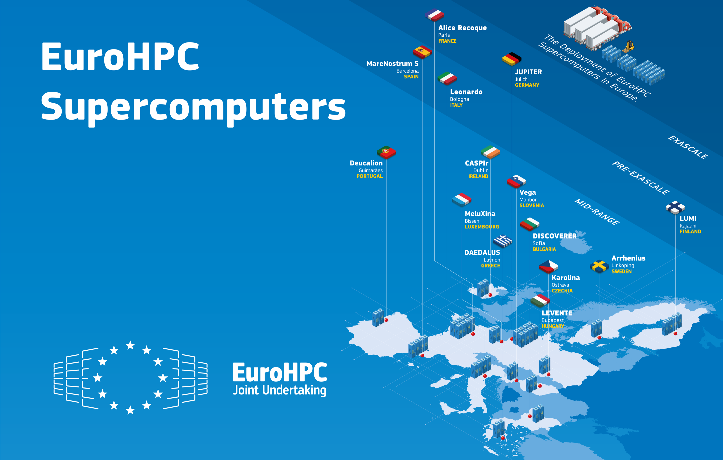
EuroHPC: 38 countries, 14 supercomputers, 10 quantum computers
14 supercomputers
Including Arrhenius in Sweden
19 AI Factories
One of them in Sweden
10 quantum computers
Hosted in 8 countries
36 competence centres
ENCCS is one of them
Figures: EuroHPC JU home page (7 October 2026) and map data (30 September 2026). Map: EuroHPC JU, 20 November 2025, CC BY 4.0

Slide 4




ENCCS structure
ENCCS sits at the intersection of LiU and RISE, combining research expertise with applied HPC capability.

Slide 5



About ENCCS
A single national door to the EuroHPC offering of HPC, HPDA and emerging technologies.
Clear path to HPC
Brokered access to EuroHPC and Swedish machines.
Services
Proofs of Concept
HPC Access
Consulting
Training
Expert Support
Sector-tailored prototyping and scalability studies.
Methods
Expert consultancy
←
Code porting, optimisation, hybrid workflows and support from domain specialists.
HPC
HPDA
Emerging tech
Hands-on skills
Practical training with industry focus.
Infrastructure
European exposure
EuroHPC devices
Swedish expertise network
Links into NCCs, CoEs, AI Factories and EU projects.
https://enccs.se/ | https://enccs.se/contact/
23

Slide 6
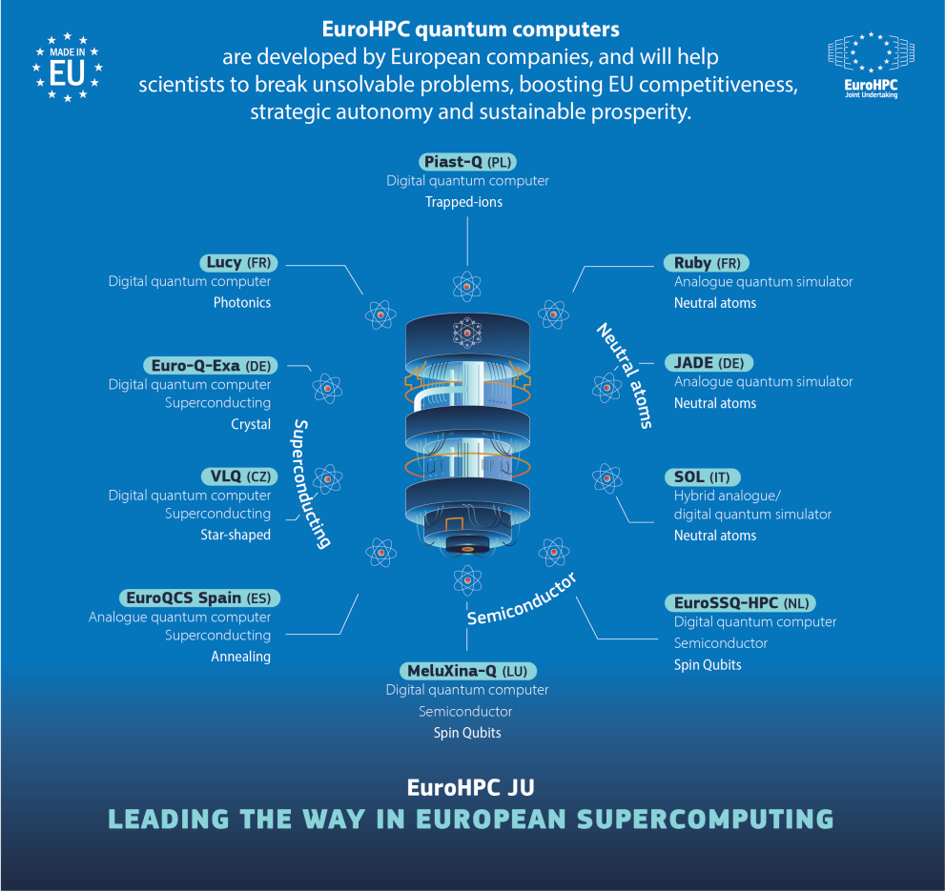
Europe now has 10 EuroHPC quantum computers, open to industry
10 EuroHPC quantum computers, 8 in operation
8 countries host them
6 technologies in the fleet
29 partners in 17 countries
Open to SMEs, researchers and industry
Each machine is paired with a EuroHPC supercomputer
Sources: EuroHPC JU (status 30 September 2026; image June 2026, CC BY 4.0); ENCCS white paper, December 2025

Slide 7
The ten quantum computers sit in eight countries
Computer | Host site | Technology | Supplier
VLQ | Ostrava, Czechia | Superconducting | IQM
Lucy | Bruyères-le-Châtel, France | Photonic | Quandela
Ruby | Bruyères-le-Châtel, France | Neutral atoms | Pasqal
Jade | Jülich, Germany | Neutral atoms | Pasqal
Euro-Q-Exa | Garching, Germany | Superconducting | IQM
EuroQCS-Italy | Bologna, Italy | Neutral atoms | Pasqal
PIAST-Q | Poznań, Poland | Trapped ions | AQT
MareNostrum-Ona | Barcelona, Spain | Annealer | Qilimanjaro
MeluXina-Q | Luxembourg | Spin qubits | To be announced
EuroSSQ-HPC | Amsterdam, Netherlands | Spin qubits | To be announced
Sources: EuroHPC JU; ENCCS, April 2026. Suppliers as of that date.

Slide 8

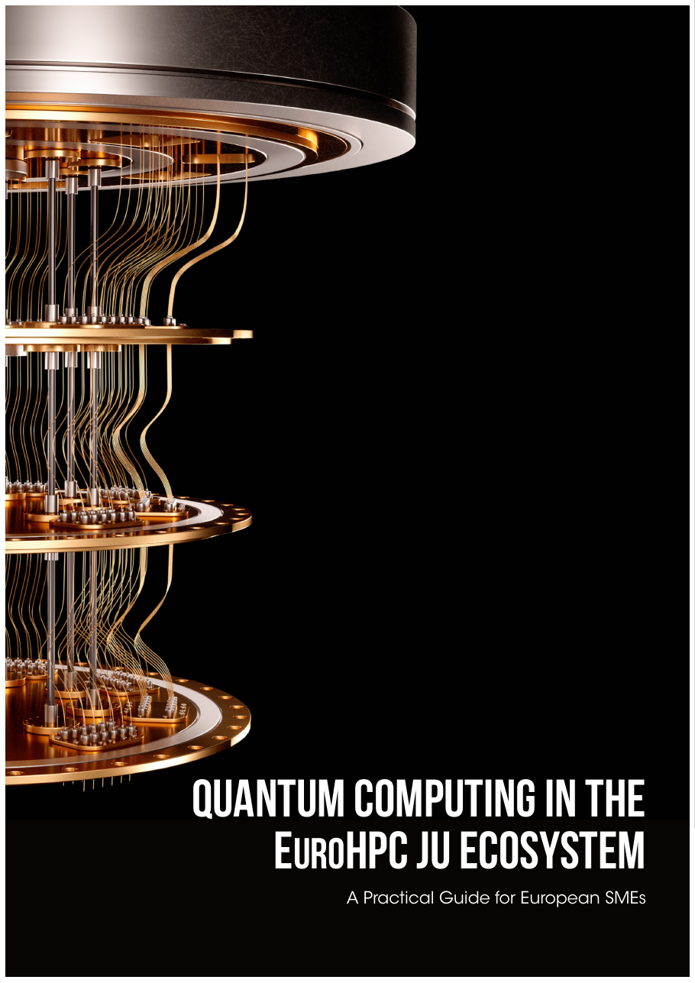
ENCCS takes you from learning quantum to running on real hardware
Learn
Quantum Autumn School, 2 to 4 November
Our flagship course, with hands-on access to real hardware
Our white paper, December 2025
A practical guide for European SMEs
Try
QSIP hackathon, 5 and 6 November
Joint awareness events with partners
Run
Apply for free access
Our guide shows how to apply for EuroHPC quantum computers
10
quantum computers
8
in operation today
6
qubit modalities
29
partners, 17 countries
Image: EuroHPC JU, June 2026, CC BY 4.0. Status: EuroHPC JU map data, 30 September 2026.

Slide 9

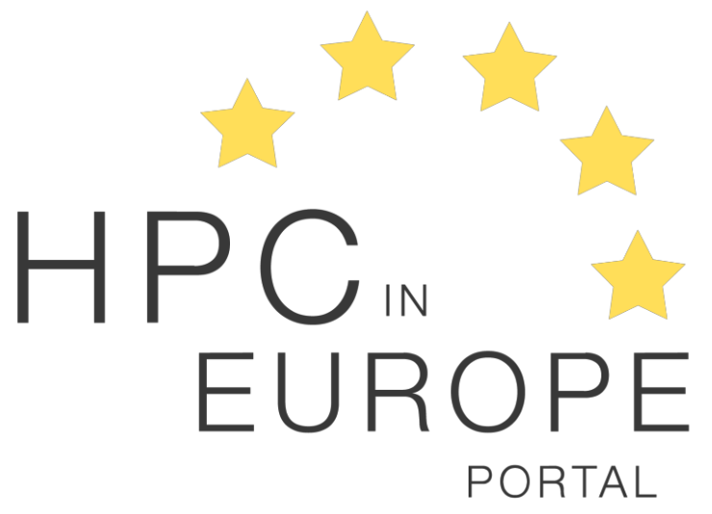

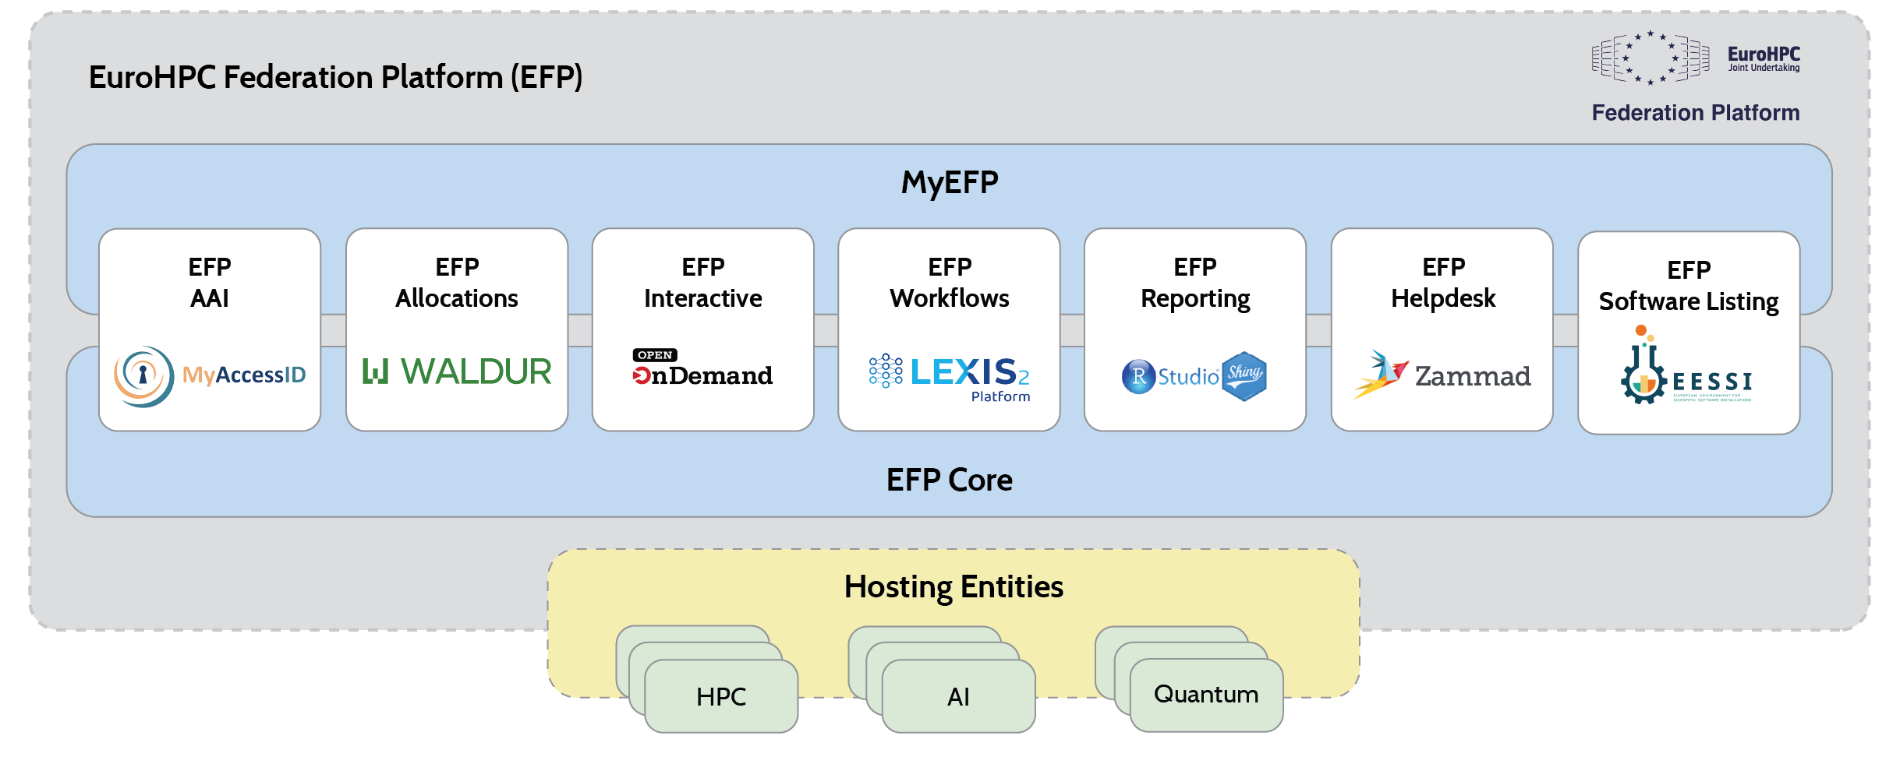
Your gateway to EuroHPC and their quantum resources
QEX & QEC4QEA
Two specialised quantum excellence centres driving quantum uptake across Europe
https://quantumdelta.nl/qex
https://www.qec4qea.eu/
HPC in Europe Portal
Find your local NCC
https://hpc-portal.eu
EuroHPC Federation Platform
Unified access portal from 2026
Single sign-on across quantum, HPC and AI
https://my-eurohpc.eu/

Slide 10
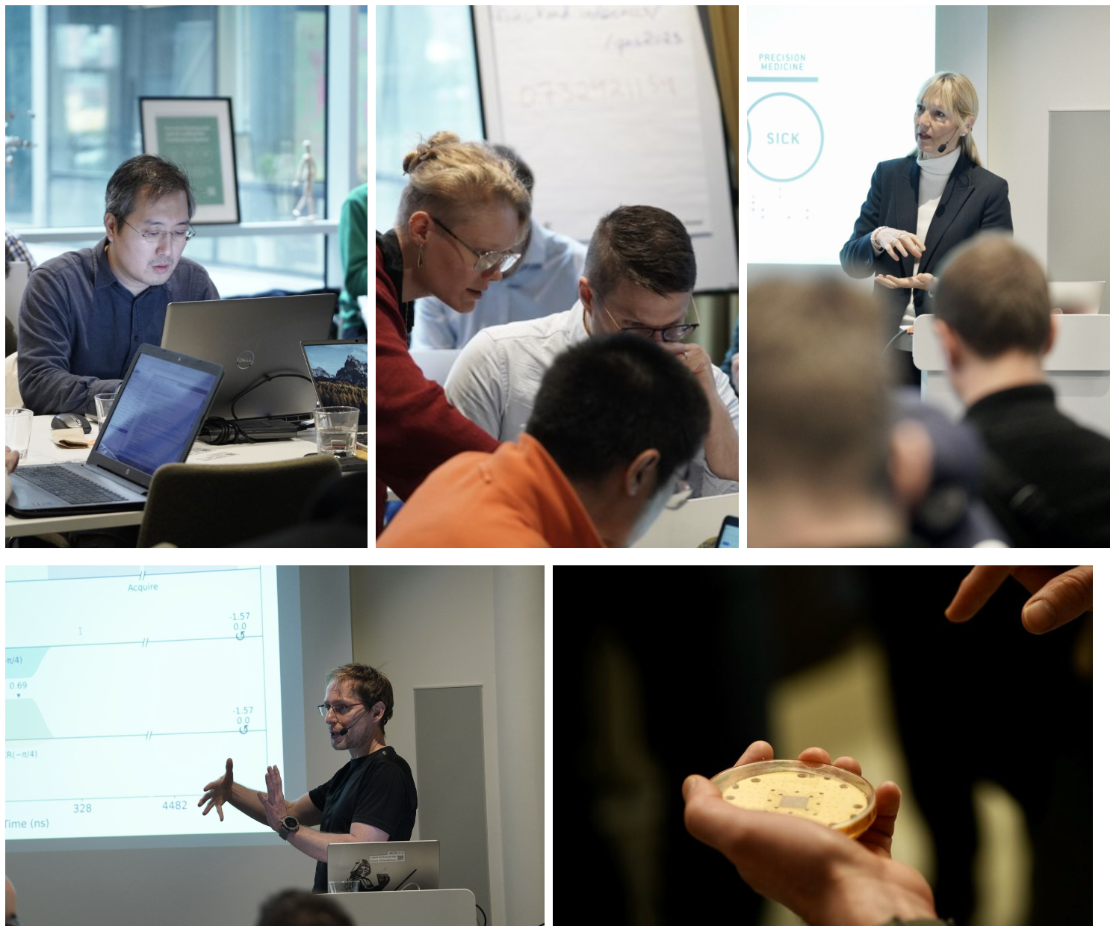

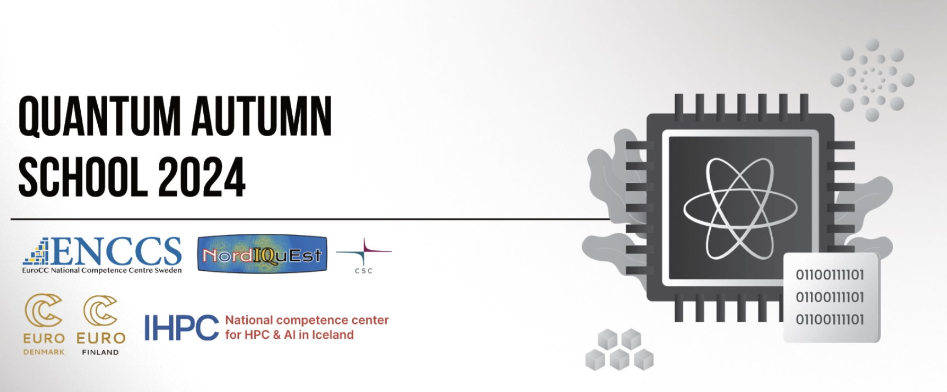
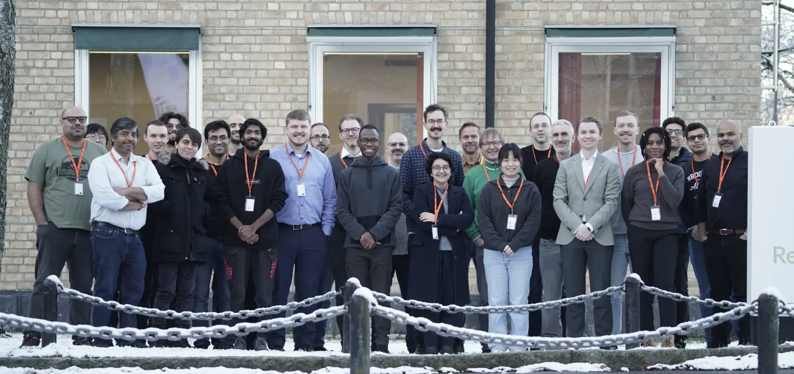

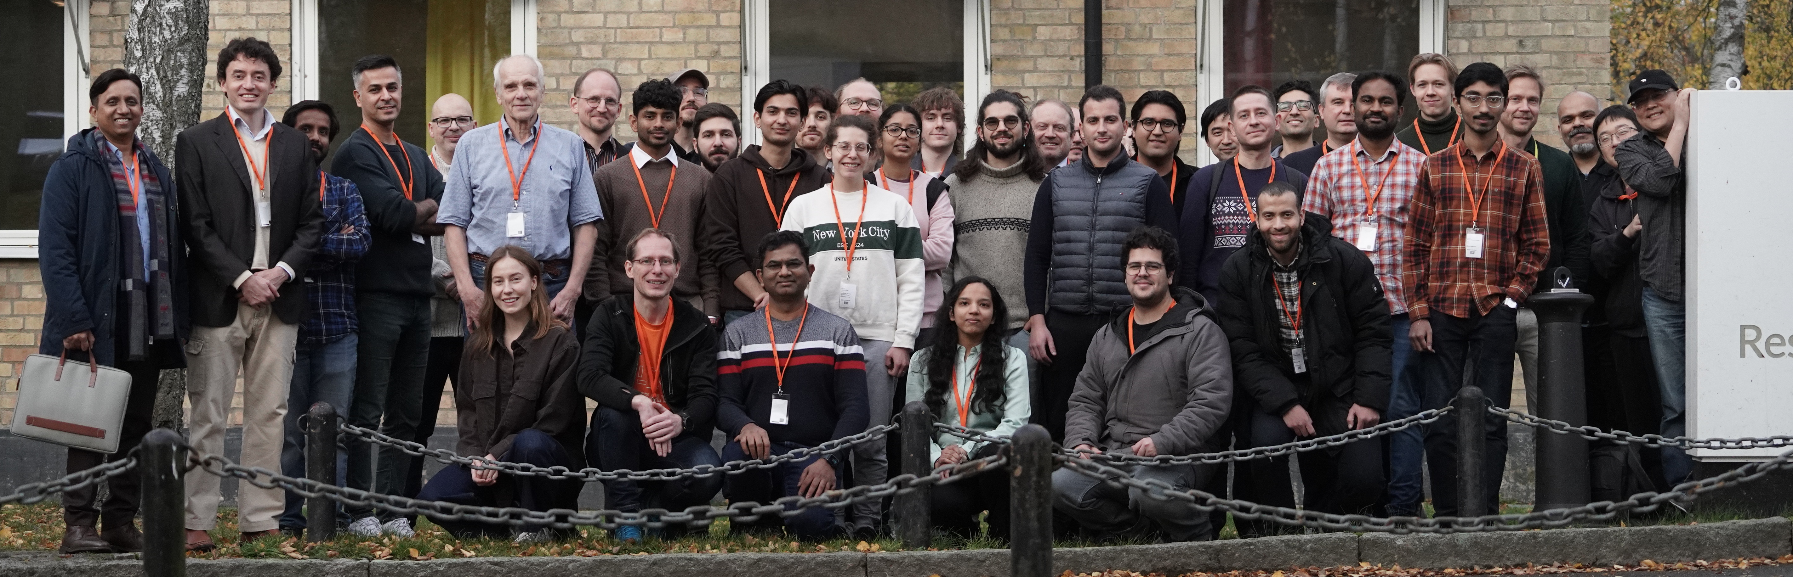
Quantum Autumn School
ENCCS flagship event for quantum computing training
Current school https://enccs.github.io/QAS26/ Previous schools https://enccs.github.io/qas2025/ https://enccs.github.io/qas2024/ https://enccs.github.io/qas2023/
Our QC flagship training in-person plus online
Organised by ENCCS with many partners over the years
Industry professionals, researchers and students at beginner to intermediate level
Speakers from industry and academia
Hands-on access to real European quantum hardware
Lectures, tutorials and networking across algorithms, use cases, HPC-QC integration and the European quantum ecosystem

Slide 11
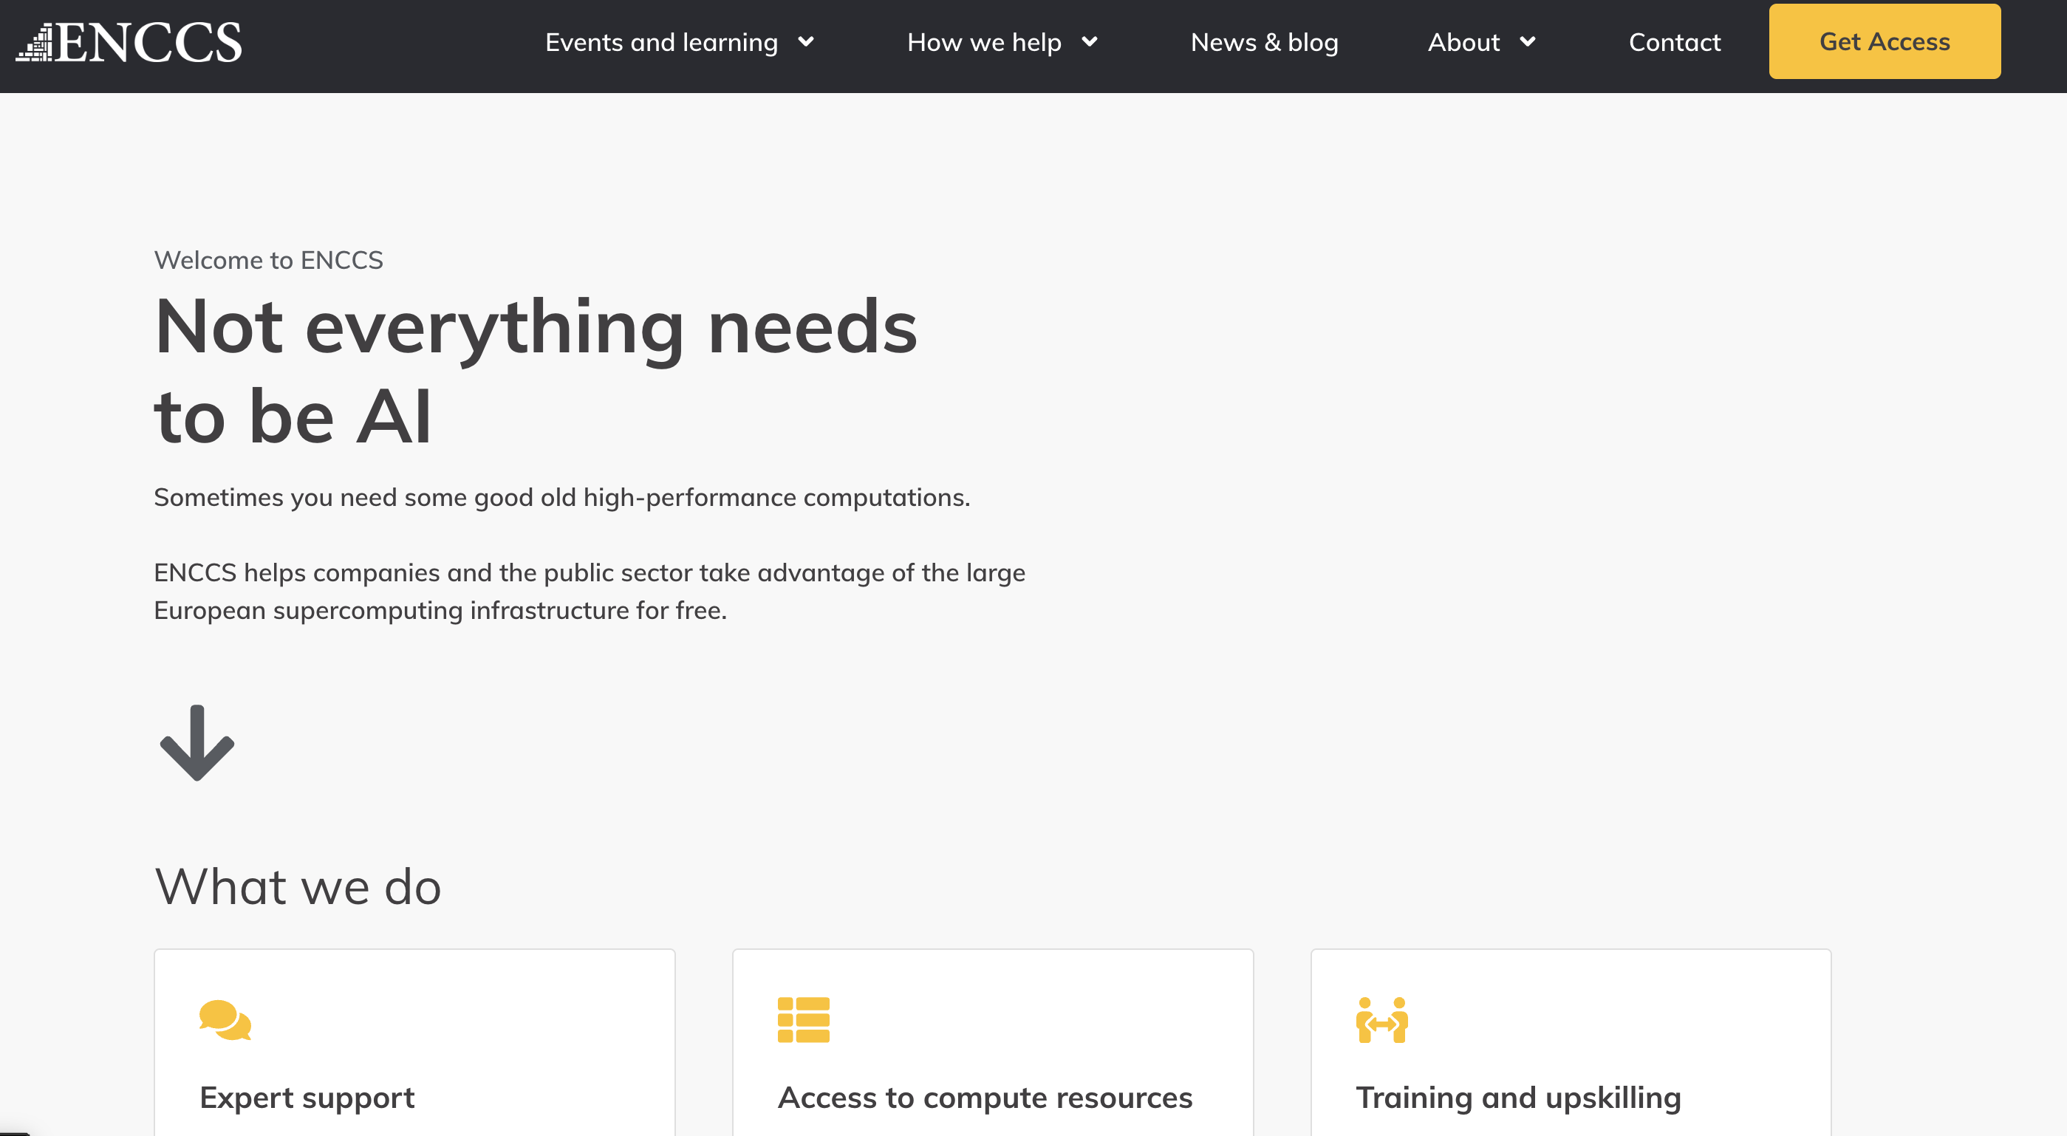




Where to continue with ENCCS after the school
ENCCS website
Training events, news and how to get help
enccs.se
Quantum Computing white paper
Quantum Computing in the EuroHPC JU Ecosystem: A Practical Guide for European SMEs
doi.org/10.5281/zenodo.17862354
HPC in Europe Portal
Find your national competence centre and European HPC news
hpc-portal.eu

Slide 12
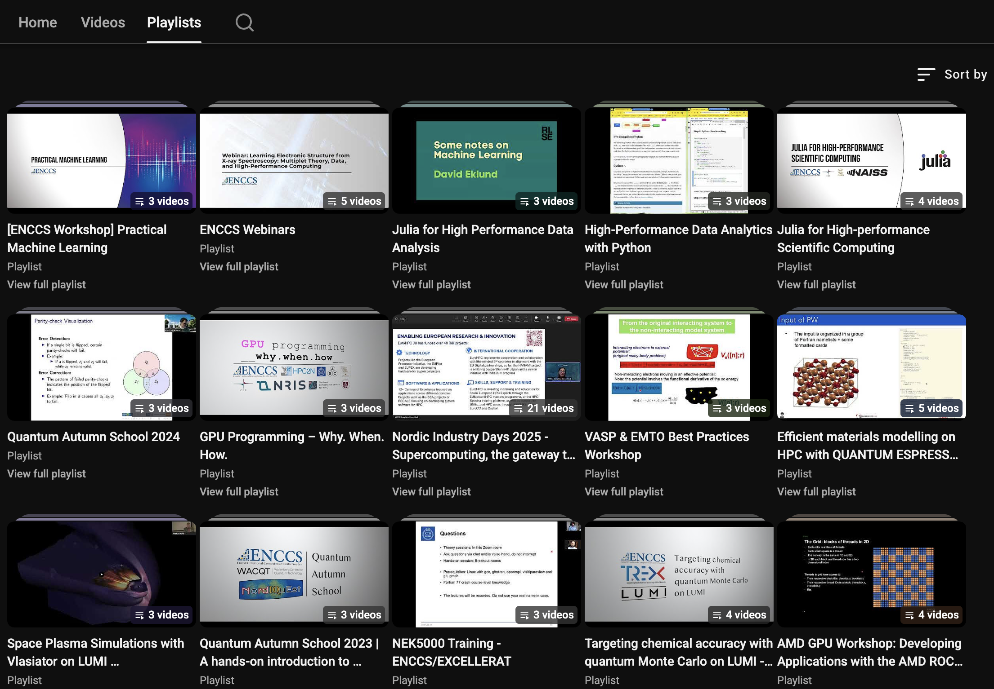

Watch ENCCS training recordings on YouTube
ENCCS on YouTube
Workshop and webinar recordings, grouped into playlists by topic
All lessons on: https://enccs.github.io/lessons/
Scan to open the playlists
youtube.com/@enccs

Slide 13
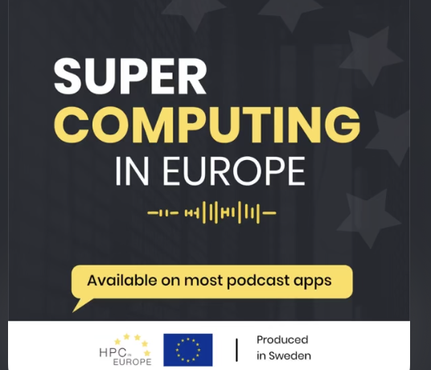
Podcast: HPC episodes
Season 2 is out. Available on Spotify, Apple Podcasts and the HPC in Europe Portal.
~40 bi-weekly episodes published to the end of EuroCC 2; Season 2 running through CC3.
Anders Dam Jensen, Executive Director, EuroHPC JU: “Building Europe’s high-end infrastructure” (April 2026).
Rodrigo Bartolomeu, MultiXscale CoE (April 2026).
David Sumpter, Twelve: our longest episode to date, 1h 20m (June 2026).
Patrick Norman, Director of KCSC, KTH: the PDC to KCSC transition, the future of Dardel, CPU partitions becoming scarce, and what corporates building in-house AI clusters should do instead (August 2026).

Slide 14
Podcast: quantum computing (+HPC-QC) episodes
Supercomputing in Europe also covers quantum computing and its link to HPC.
Mikael Johansson, CSC: “Quantum computing and Europe”, quantum computing uptake and communications in the European HPC ecosystem (October 2025).
Stefan Seegerer, Head of Product, IQM Quantum Computers: “Building quantum computers in Europe” (December 2025).
Matthias Christandl, Professor of Quantum Computing, University of Copenhagen: simulating a 40-qubit quantum algorithm on an AI supercomputer (February 2026).
Panagiotis Barkoutsos, Senior Staff Quantum Solutions, IonQ: “Developing quantum solutions with IonQ”, recorded at QAS2025 in Stockholm (March 2026).

Slide 15

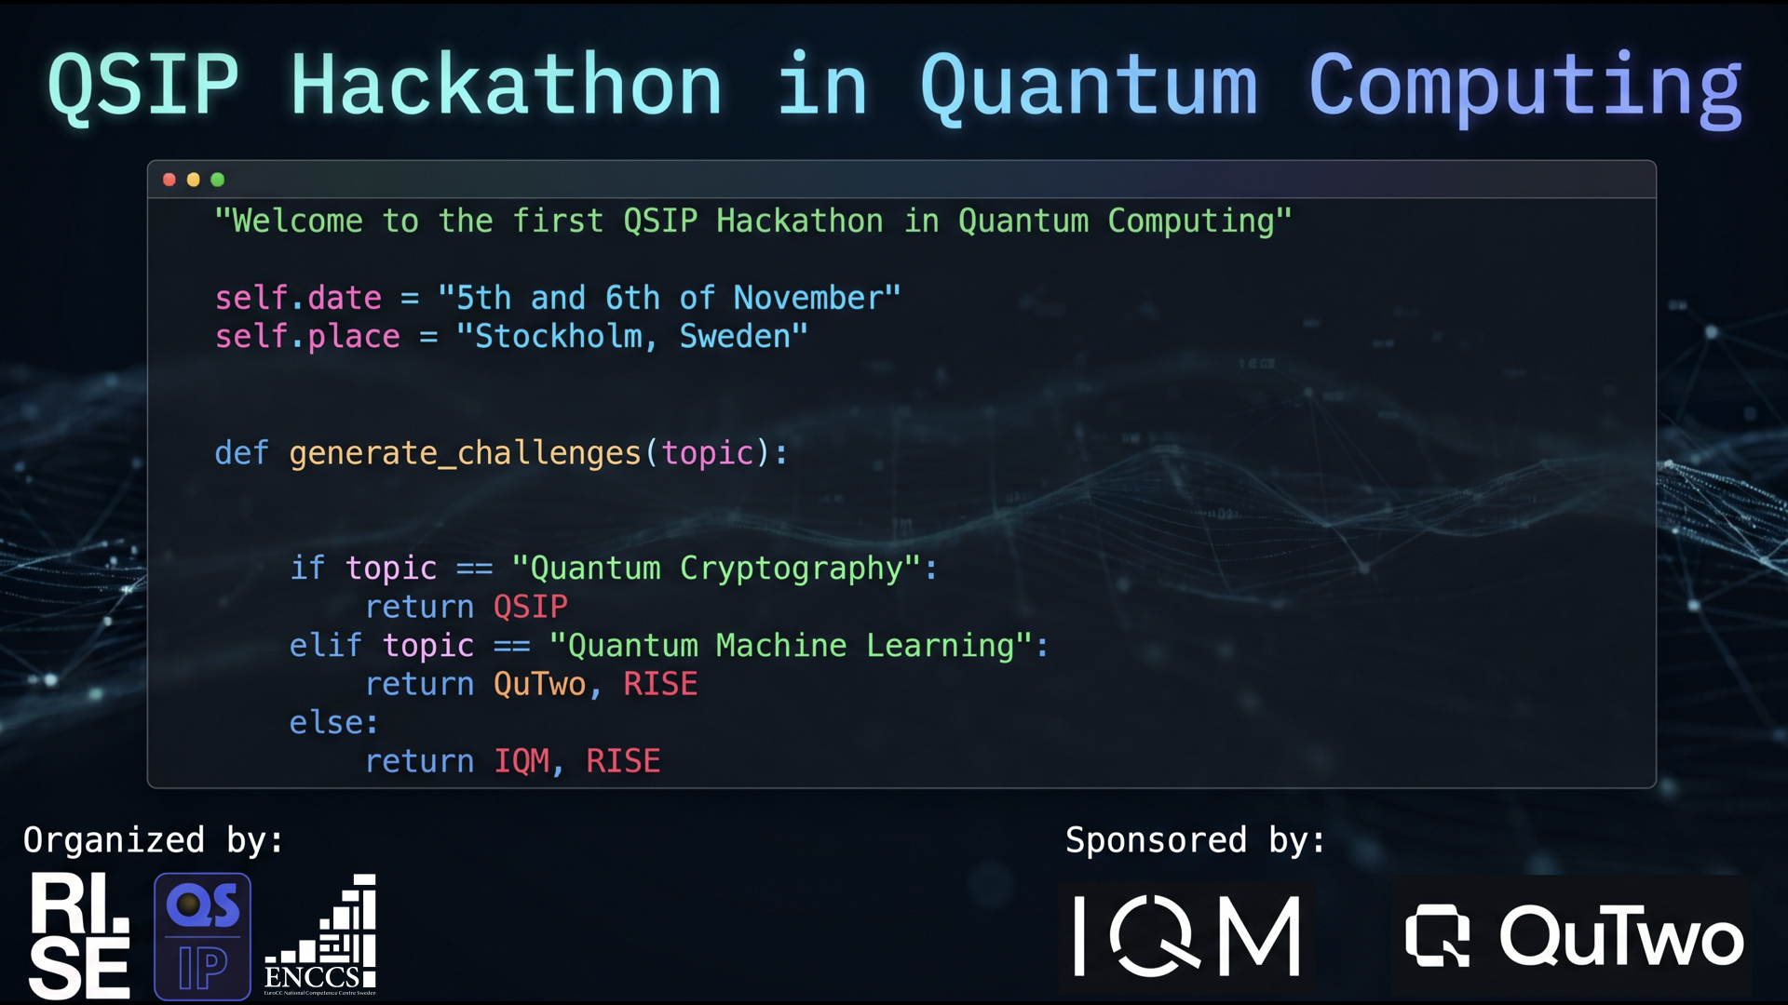

Slide 16



Funding acknowledgement
hpc-portal.eu
EuroCC 3 has received funding from the European High-Performance Computing Joint Undertaking (JU) under Grant Agreement No. 101306701. The JU receives support from the European Union's Digital Europe Programme and Germany, Albania, Austria, Belgium, Bosnia and Herzegovina, Bulgaria, Croatia, Cyprus, Czechia, Denmark, Estonia, Finland, France, Greece, Hungary, Iceland, Ireland, Italy, Latvia, Lithuania, Luxembourg, Malta, Montenegro, the Netherlands, North Macedonia, Norway, Poland, Portugal, Romania, Serbia, Slovakia, Slovenia, Spain, Sweden, Türkiye, and Kosovo.
Funded by the European Union. Views and opinions expressed are however those of the author(s) only and do not necessarily reflect those of the European Union or EuroHPC Joint Undertaking. Neither the European Union nor the EuroHPC Joint Undertaking can be held responsible for them.
ENCCS has also received national funding through Vinnova and the Swedish Research Council (VR).
The project is supported by the European High-Performance Computing Joint Undertaking and its members.

Slide 17
Thank you
ENCCS is the Swedish node of the EuroCC 3 project. EuroCC 3 has received funding from the European High-Performance Computing Joint Undertaking (JU) under Grant Agreement No. 101306701. The JU receives support from the European Union's Digital Europe Programme and Germany, Albania, Austria, Belgium, Bosnia and Herzegovina, Bulgaria, Croatia, Cyprus, Czechia, Denmark, Estonia, Finland, France, Greece, Hungary, Iceland, Ireland, Italy, Latvia, Lithuania, Luxembourg, Malta, Montenegro, the Netherlands, North Macedonia, Norway, Poland, Portugal, Romania, Serbia, Slovakia, Slovenia, Spain, Sweden, Türkiye, and Kosovo.
Funded by the European Union. Views and opinions expressed are however those of the author(s) only and do not necessarily reflect those of the European Union or EuroHPC Joint Undertaking. Neither the European Union nor the EuroHPC Joint Undertaking can be held responsible for them.
ENCCS has also received national funding through Vinnova and the Swedish Research Council (VR).
10

